Slide 1
Appendix:
Data sets and open source
Dr. Roderik Lindenbergh
Dr. Linh Truong-Hong
Optical and Laser Remote Sensing Group
Department of Geoscience & Remote Sensing

Slide 2
Data sets
Dublin ALS: https://wp.nyu.edu/urbanmodeling/our-work/our-data/
Robotic 3D Scan: http://kos.informatik.uni-osnabrueck.de/3Dscans/
USA state LiDAR: https://viewer.nationalmap.gov/basic/
Canada LiDAR: https://canadiangis.com/free-canada-lidar-data.php
Large scale point cloud classification: http://semantic3d.net/
UCL data set: http://www.synthcity.xyz/download.html
Phonix LiDAR (requested): https://www.phoenixlidar.com/sampledata/
Indoor benchmark data: http://indoor-bench.github.io/indoor-bench/

Slide 3
Open source and Libraries
CloudCompare: https://www.danielgm.net/cc/
PCL: http://pointclouds.org/
Lastool (not fully free): https://rapidlasso.com/lastools/
Potree: http://potree.org/
Point Cloud Tool for Matlab: https://www.geo.tuwien.ac.at/downloads/pg/pctools/pctools.html
3DTK: https://sourceforge.net/p/slam6d/code/HEAD/tree/trunk/

Slide 4
Online tutorial
https://www.youtube.com/watch?v=1mqHQZ39O14
https://www.youtube.com/watch?v=BhHro_rcgHo

Slide 5
Exercise
Exercise 1: Dat Hop Company
Exercise 2:
- Data registration by artificial targets: Dat Hop Company
- ICP:
Tool: Cloudcompare
Data sets: Building_01_station_1.txt
Building_01_station_2.txt
- Outlier:
Tool: CloudCompare: Statistical Outlier Removal
Data set: Wicklow Bridge UAV All-212 images.txt Matlab: Histogram on intensity; filtering
Data sets: Bridge_01_station_1.txt
Bridge_01_station_1_section.txt
- Subsampling and Crop:
Tool: CloudCompare
Data set:

Slide 6
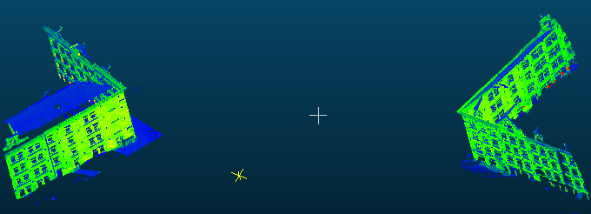
Exercise 2: ICP
- Input data
Reference data
Sampling data

Slide 7
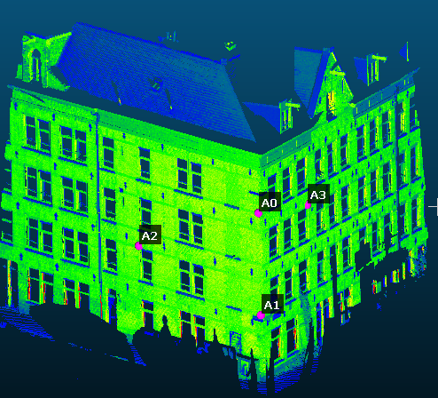
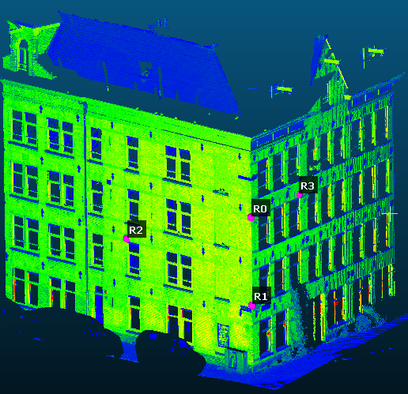
Exercise 2: ICP
- Rough alingment
Reference data
Sampling data

Slide 8
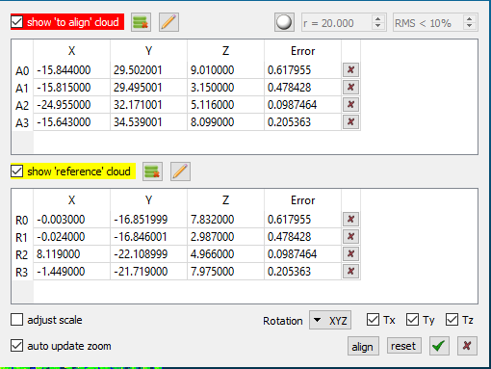
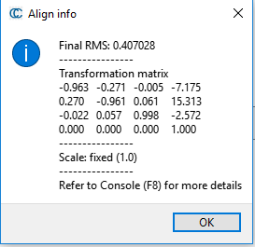
Exercise 2: ICP
- Rough alignment
Reference data
Sampling data

Slide 9
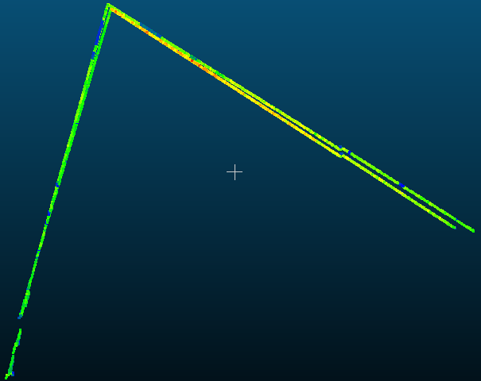
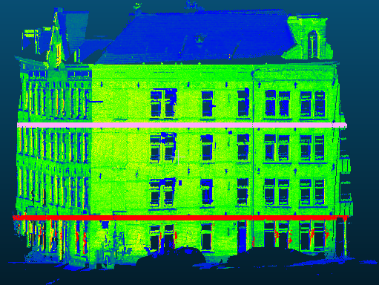
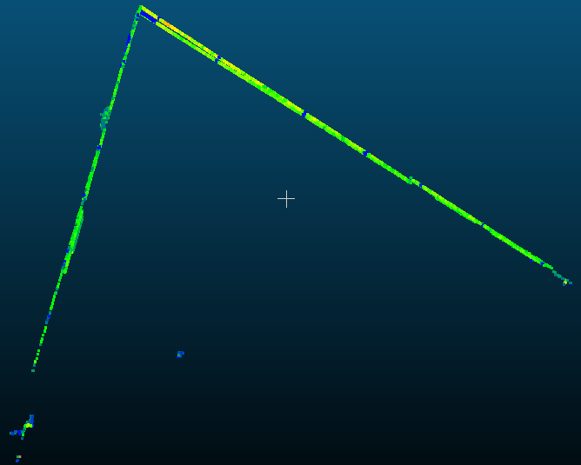
Exercise 2: ICP
- Rough alignment
Section 1
Rough alignment
Section 2

Slide 10
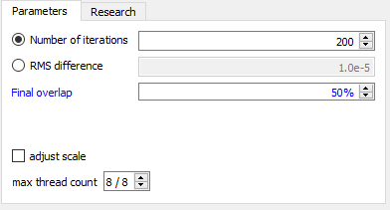
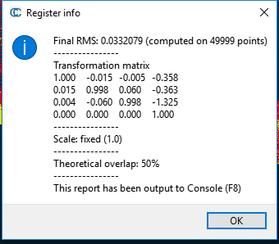
Exercise 2: ICP
- Fine alignment
Parameters setting
Resulted fine alignment

Slide 11
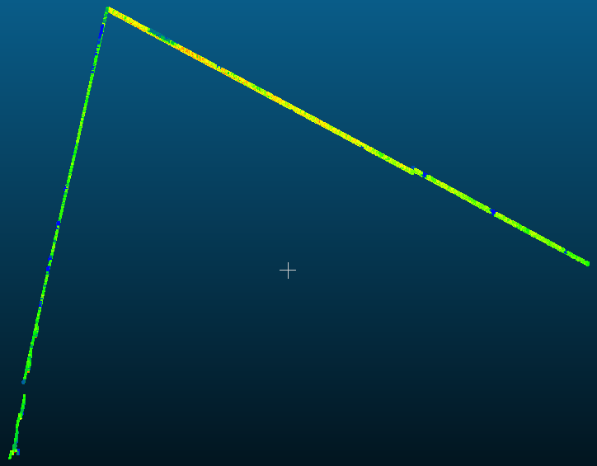
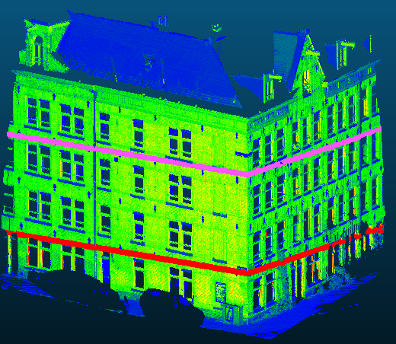
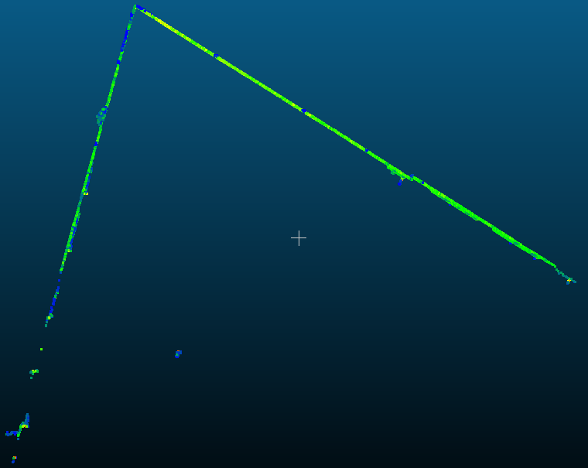
Exercise 2: ICP
- Fine alignment
Section 1
Fine alignment
Section 2

Slide 12
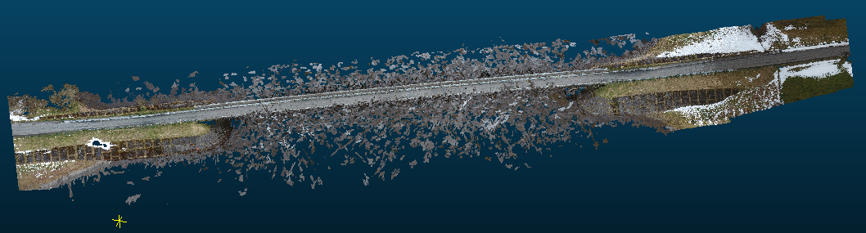
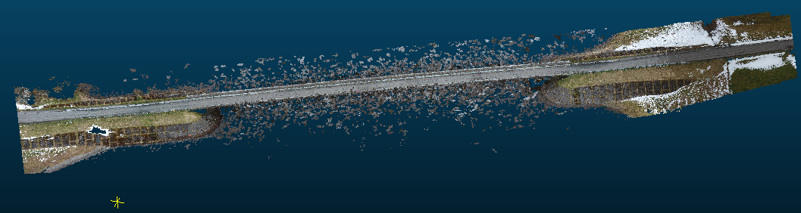
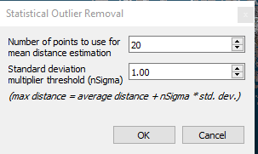
Exercise 2: Outlier removal
Wicklow Bridge UAV point cloud: 34,523,263 pts
Filtering outlier points, the remaining points: 32,815,409 pts

Slide 13
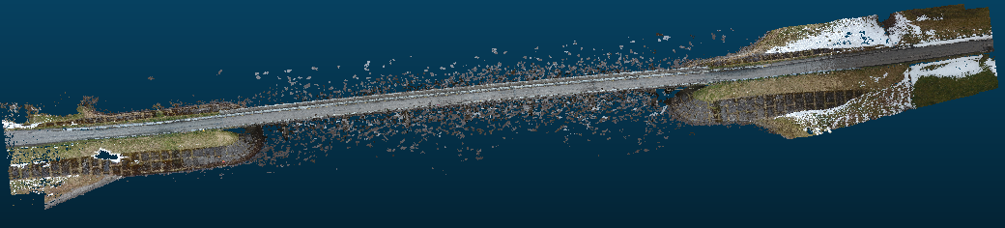
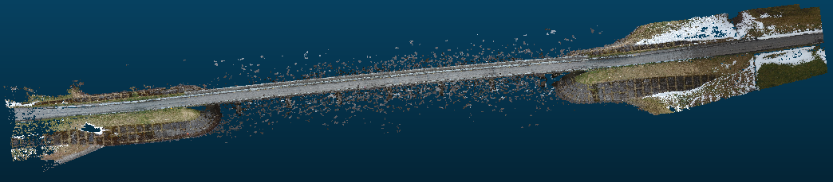
Exercise 2: Outlier removal
Filtering outlier points, the remaining points: 30,786,023 pts
Filtering outlier points, the remaining points: 29,420,418 pts

Slide 14
Exercise 2: Subsampling

Slide 15
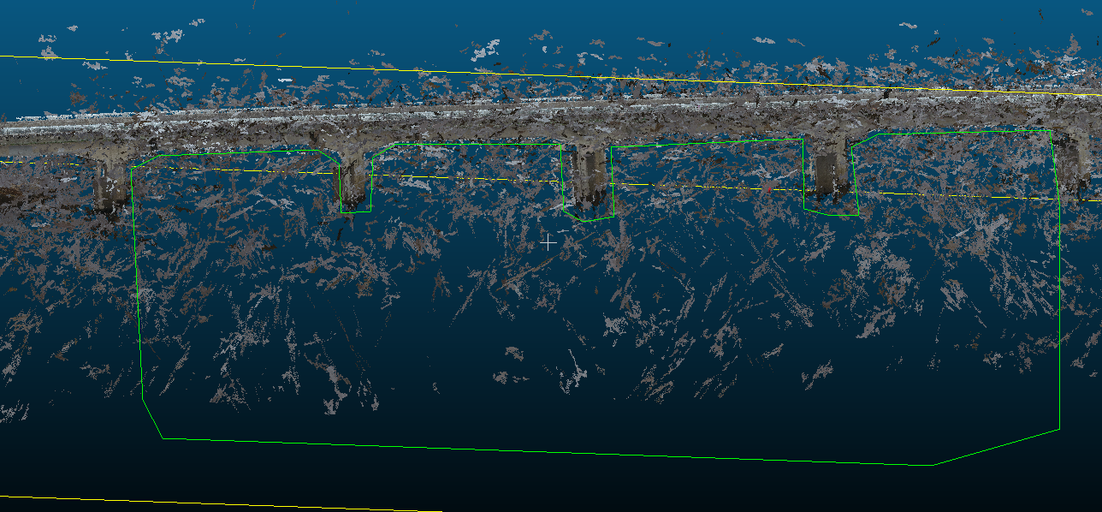
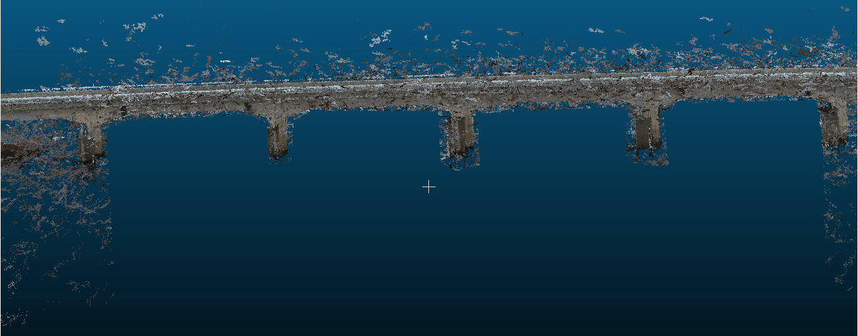
Exercise 2: Crop
Cropping Wicklow Bridge UAV point cloud: 34,523,263 pts
After cropping Wicklow Bridge UAV point cloud: 34,114,896 pts

Slide 16
Exercise
Exercise 3:
- Compute feature of points:
Tool: CloudCompare
Data: Building_01_station_2.txt
Bridge_02_Pylon.txt
Tool: Matlab
Data: Column.txt
- Segmentation:
Tool: CloudCompare/Ransac
Data: Building_01_station_2.txt
Bridge_02_Pylon.txt
Matlab: Region growing
Data: Column.txt
- Fitting line, plane, and cylinder:
Tool: CloudCompare
Data: CylinderData.e57

Slide 17
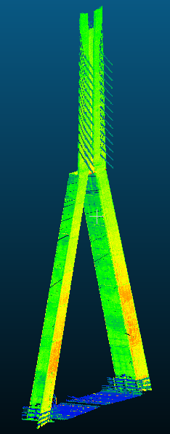
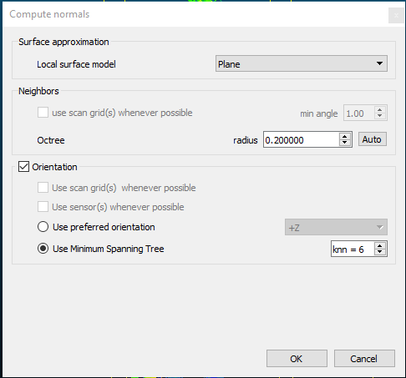
Exercise 3: Ransac Segmentation
Compute normal vectors for each points
Data points of the pylon

Slide 18
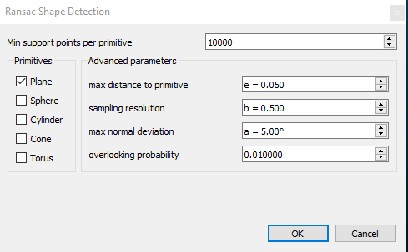
Exercise 3: Ransac Segmentation
Define parameters for Ransac segmentation
Ref: Schnabel, R., Wahl, R., & Klein, R. (2007). Efficient RANSAC for point‐cloud shape detection. Computer Graphics Forum, 26(2), 214-226

Slide 19
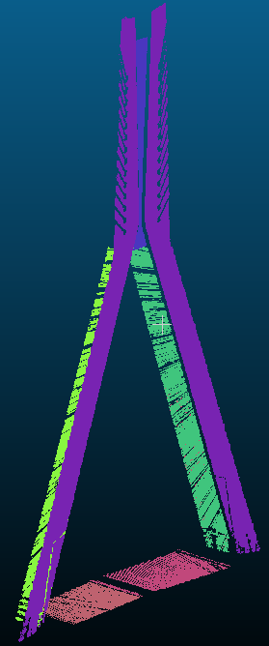

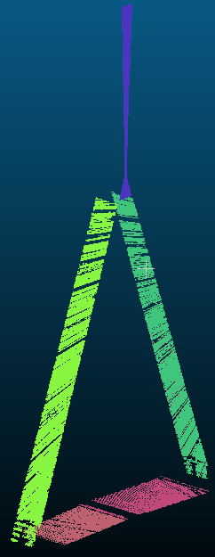
Exercise 3: Ransac Segmentation
Resulted Ransac segmentation
Segmentation 1
Segmentation 2-6

Slide 20
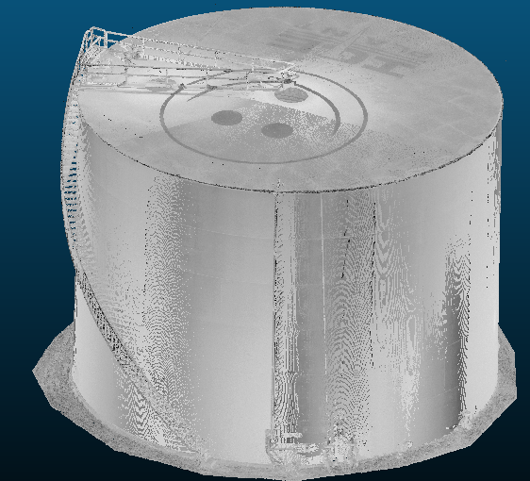
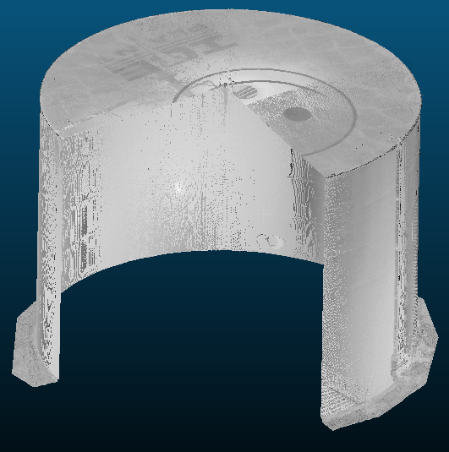
Exercise 3: Fitting cylinder

Slide 21
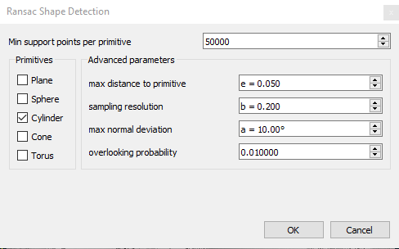
Exercise 3: Fitting cylinder
Ref: Schnabel, R., Wahl, R., & Klein, R. (2007). Efficient RANSAC for point‐cloud shape detection. Computer Graphics Forum, 26(2), 214-226

Slide 22
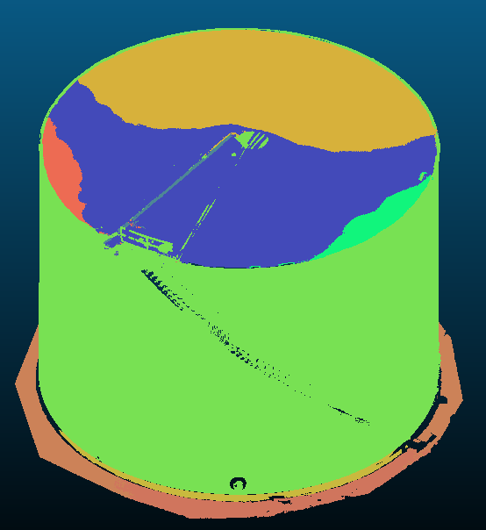

Exercise 3: Fitting cylinder
Resulted Ransac segmentation: 10 segments
Segmentation of the tank wall

Slide 23
Exercise
Exercise 4: VTM solution

Slide 24
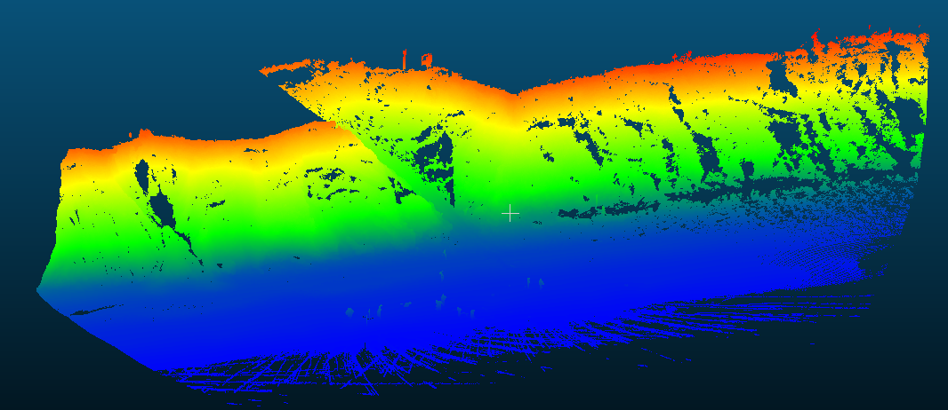
Exercise 6: Contour generation

Slide 25
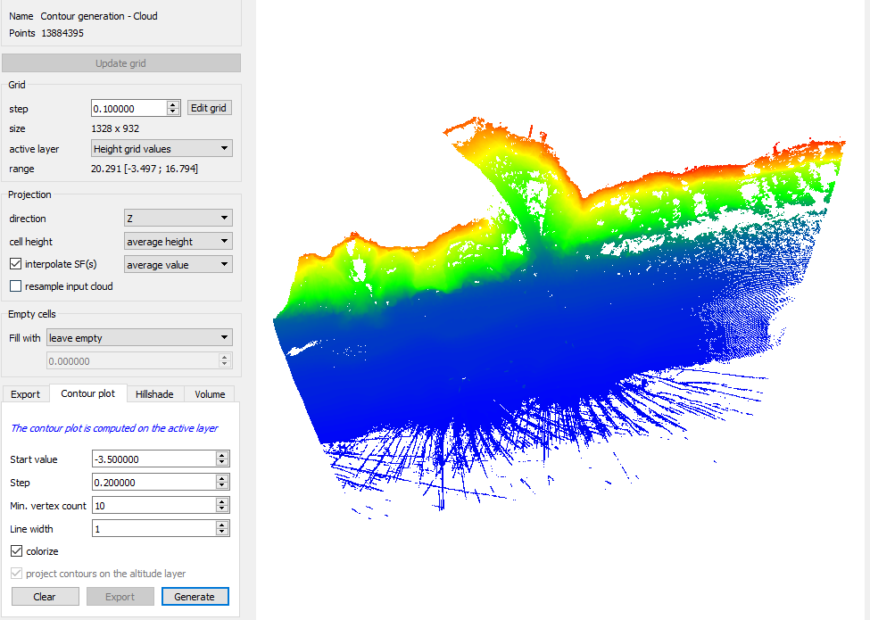
Exercise 6: Contour generation

Slide 26
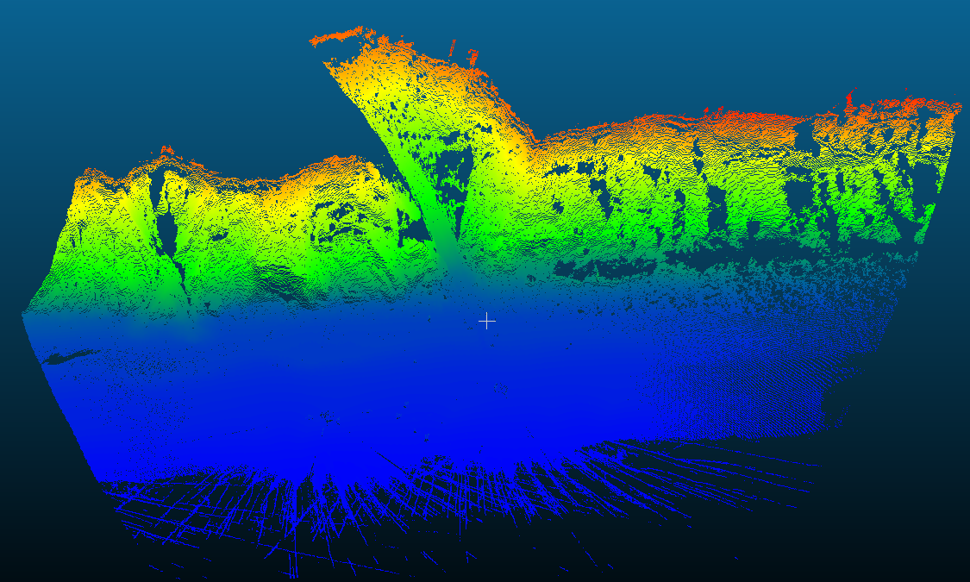
Exercise 6: Contour generation

Slide 27
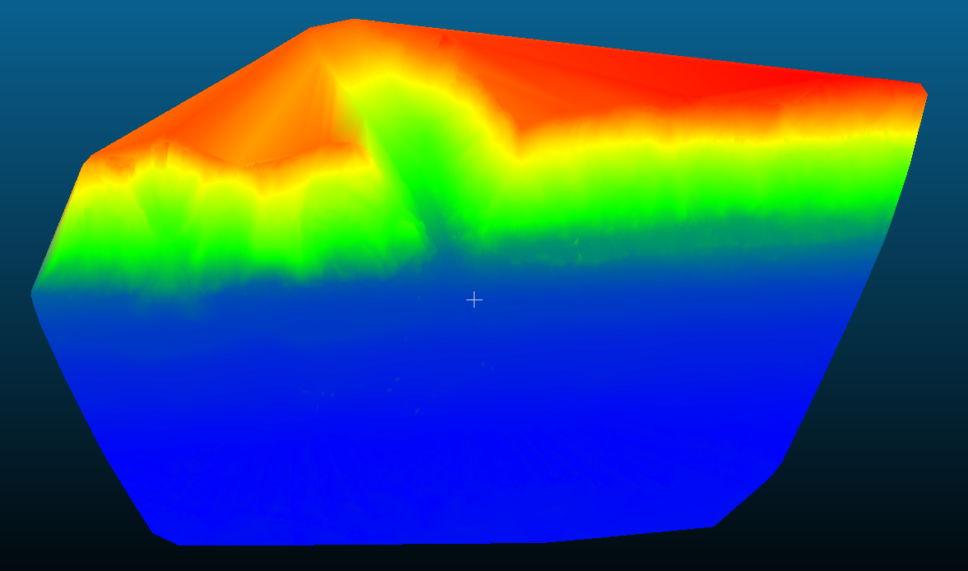
Exercise 6: Contour generation

Slide 28
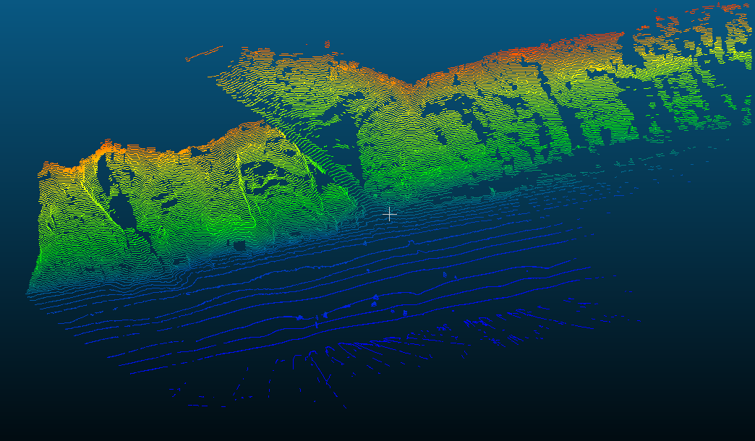
Exercise 6: Contour generation

Slide 29
Exercise 6: Contour generation

